Slide 1
LT 6.2 Fake Quiz

Slide 2
What type of reaction?
NaOH + CuSO₄ → Na₂SO₄ + Cu(OH)₂
C₄H₁₂ + O₂ → H₂O + CO₂
Fe + O₂ → Fe₂O₃
Mg₃(PO₄)₂ + H₂ → Mg + H₃PO₄
NH₄NO₃ → N₂O + H₂O

Slide 3
LT 6.2 Predicting Products Notes

Slide 4
What type of reaction will happen?
C₆H₁₄ + O₂ →
Al + F₂ →
CaCO₃ →

Slide 5
Predicting Products for Combustion Rxns
Reactants are always a hydrocarbon and O₂
Products are always CO₂ and H₂O
Write the formula, then balance!

Slide 6
Predicting Products for Combustion Rxns
C₆H₁₄ + O₂ →

Slide 7
Practice
C₃H₈ + O₂ →

Slide 8
Predicting Products for Synthesis Rxns
Reactants are always single elements
Combine to make an ionic compound
- use charges to determine the compound
Then balance!

Slide 9
Predicting Products for Synthesis Rxns
Al + F₂ →

Slide 10
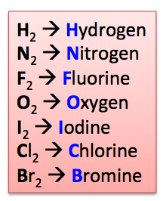
Diatomic Elements
Some atoms are diatomic—they come in pairs when they are single elements
Does NOT apply to ionic compounds—only when by themselves!

Slide 11
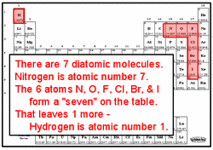

Slide 12
Common mistake: H₂O
“Why is there only one oxygen in H₂O? I thought oxygen was diatomic and could only come in pairs? Shouldn’t it be H₂O₂?”

Slide 13
Practice
Mg + N₂ →

Slide 14
Practice
Fe (III) + O₂ →

